Slide 1

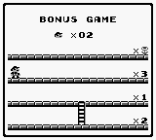

( Virtual )
Event Sourcing and CQRS
on Azure serverless functions
Duncan Jones
💬 @Merrion
Notes:
Good afternoon and thank you for lending me your time.
The Coronavirus means that the Global Azure event has been turned virtual so this is the talk I was going to give “Event Sourcing and CQRS on Azure serverless functions”
As this is not live (and therefore cannot support a Q&A) you can reach out to me on Twitter as @Merrion with any questions,

Slide 2
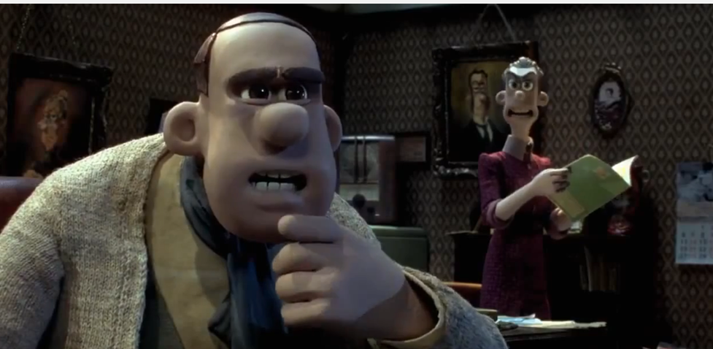
Demo– adding interest
“We accrue interest on a daily basis based on the account balance at that time,
But we only pay the accrued interest at the end of every month”

Slide 3


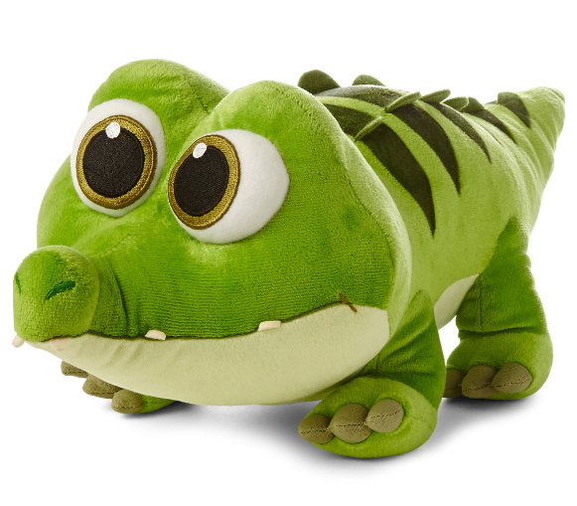

Accrue interest
“We accrue interest on a daily basis based on the account balance at that time”
Target account number for the interest accrual must exist
Interest rate for accounts in credit
Interest rate for accounts in debit
Concurrency crocodile?
BALANCE
Event Type | Action

Slide 4
Pay interest
“But we only pay the accrued interest (that was accrued) at the end of every month”
Event Type | Action
Interest accrued | Increase the accrued amount by $
Interest paid | Decrease the accrued amount by $
INTEREST DUE

Slide 5

Pay interest
“But we only pay or collect the accrued interest (that was accrued) at the end of every month”
Target account number for the interest accrual must exist
Concurrency crocodile?
What if the account cannot afford to pay us interest it owes ?

Slide 6
Pay interest
“But we only pay or collect the accrued interest (that was accrued) at the end of every month and extend the overdraft if they need it”
Target account number for the interest accrual must exist
Concurrency crocodile?

Slide 7
Extend the overdraft if they need it
Target account number for the overdraft increase must exist
Event Type | Action
BALANCE
INTEREST DUE
Concurrency crocodile?
OVERDRAFT

Slide 8

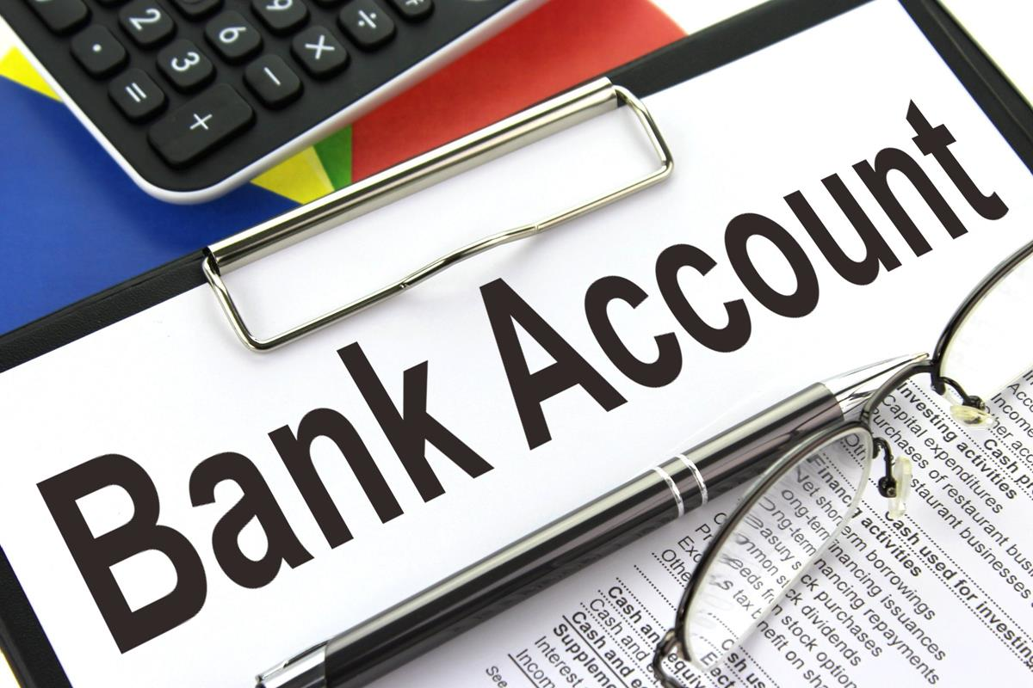


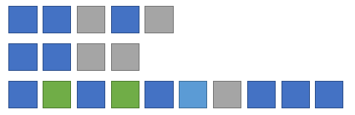
Handling a command
Durable Function Orchestration
Command name
Parameters
Context
Fan-out
Command
Validations
Append
Event(s)
Notes:
A command is issued to the system through an event grid topic.
The parameters required to perform the command as well as any authorisation tokens and externally supplied unique identifier are supplied in the payload to this event grid topic.
When a message is received by the topic it triggers a serverless function to handle the command.
This uses the durable function framework to call activities that perform each step in turn and, if all is OK, appends 1 or more events to the event streams of the entities updated by the command.
As well as the built in durable function orchestration which is backed by a table the command has its own event stream in which the progress is logged.

